Slide 1

Predicting Hotel Booking Cancellation
Group name: B4 Neena Chaudhari
Anjali Devrani
Durga Sumitra Duggirala
Ragini Jakkam
Navya Madhuri Buyyana Pragada

Slide 2
The Problem with Cancellations
Solution
In order to ﬁght the negative effects of cancellations, hotels need to be able to identify which bookings are likely to be canceled.
We will build a classiﬁcation model to predict whether or not a booking will be canceled with the highest accuracy possible.
This model will allow hotels to predict if a new booking will be canceled or not, manage their business accordingly, and increase their revenue.
40% cancellation rate in 2018
Customer became habitual to free cancellation policies
Operational problems

Slide 3

The Data
From: Kaggel
Bookings due to arrive between the July 1, 2015 and August 31, 2017.
40,060 Hotel 1 (Resort)
79,330 Hotel 2 (City)
32 Variables

Slide 4
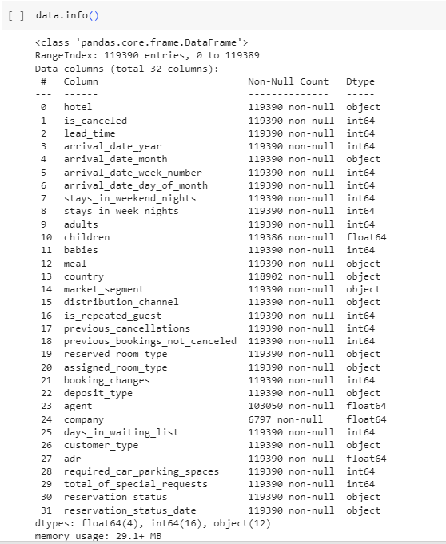

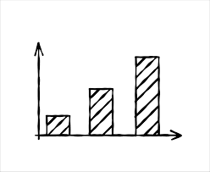
Columns in the Dataset

Slide 5

Workﬂow
Data collection
Understanding the data
Data Cleaning
EDA
Model evaluation
Training the Model
Applying the Models
Splitting the Data
Running the Model on dummy data
Conclusion & Recommendation

Slide 6

Data Cleaning
If there's no information in the 'children' column, we'll put a 0 there instead.
If there's no information in the 'country' column, we'll put country that appears most often in the 'country' column by counting how many times each country is listed.
Dropping columns "agent" and "company" from the DataFrame as they contain many null values
Since it's unrealistic for a hotel room to be booked with 0 adults, we will remove any rows in which the 'adults' column has a value of 0.
Some values in the 'adr' column are below 0, which is impossible because hotels should not owe money to guests.
Remove outlier : Drop the rows where the "adr" column has a value greater which is unrealistic compare to other values 5000
Combine columns : we have stays in weekend nights and week nights, so we are calculating total_stays
We also combined 'children' and 'babies' into one category called 'kids' because they are similar.

Slide 7
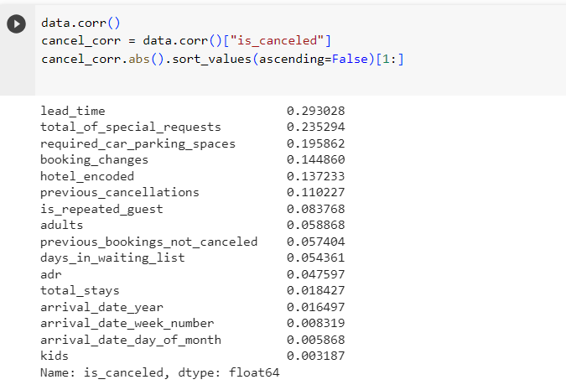
Correlation Matrix

Slide 8


Exploratory Data Analysis
We have two types of hotels which were ‘City hotels’ and ‘Resort hotels’.
0 is for booking confirmation and 1 is for booking cancelation.
From the table we got to know that there is 63% of booking confirmation and 37% of cancellations.
It clearly shows that there were more number of confirmations than cancellations.

Slide 9
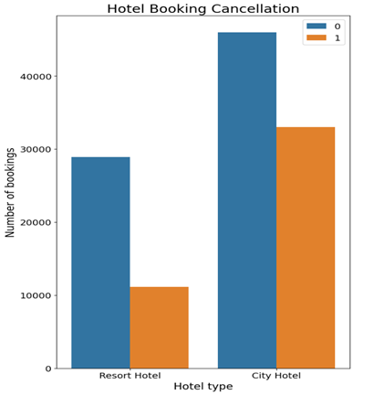
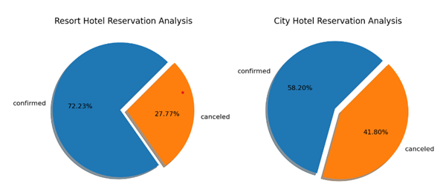
Hotel Bookings and Cancellation
There are more bookings in City Hotel than in Resort.
Bookings in Resorts which were confirmed were 72.23% and canceled were 27.77%.
On the other hand Bookings in City Hotel which were confirmed were 58.20% and canceled were 41.80%.
There is almost 33.33% more bookings in city hotels.
The number of cancellations in city hotel is almost thrice the number of cancellations in resort hotel.

Slide 10
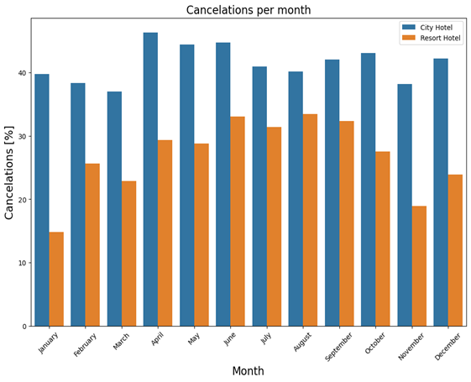
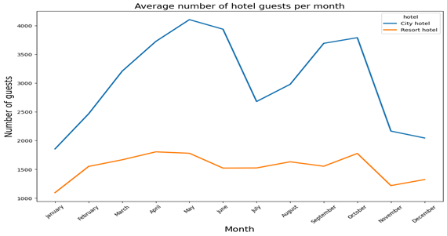
EDA
Cancellation Per Month
Cancelation was maximum in April at City Hotel whereas in Resort it was in August.
Cancellation was least in january for resort hotel and march for city hotel.
There is a significant dip in number of guests from june to july and october to november for city hotel.
Hotel Guest Per Month
Number of guests in resort hotel is nonetheless same throughout the year.
Number of guests is inconsistent from may till end of year for city hotel.
There is linear increase in number of guests from January to may for city hotel.

Slide 11
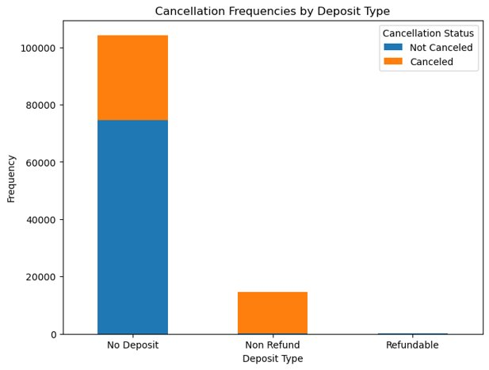
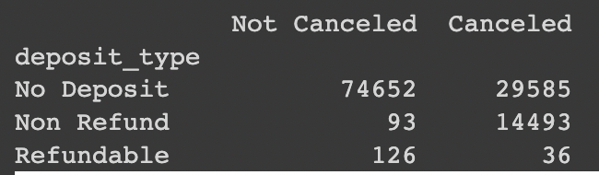
Deposit Type
Customers who pay a non-refundable deposit have a much higher percentage of canceled reservations
Hotel deposit policies with refundable deposit have less number of cancellations.

Slide 12
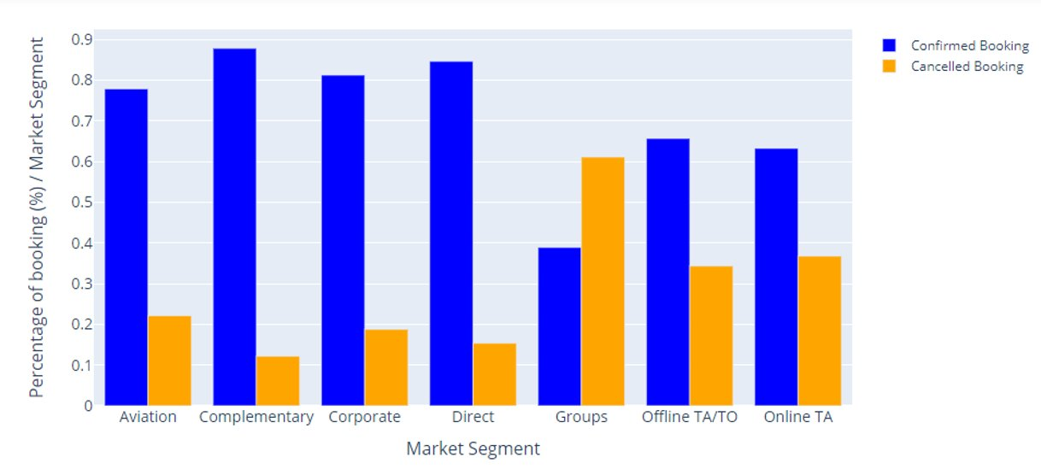
Market Segment
We observe that bookings which have been booked in groups have the highest percent of cancellations.
We observe Offline TA/TO and Online TA also have about 40% of cancellations.
Complementary bookings have the least number of cancellations.

Slide 13

Models
Logistic Regression
KNN
Neural networks
Decision tree
Random Forest

Slide 14

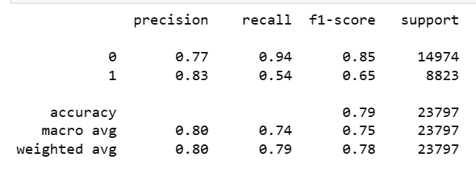
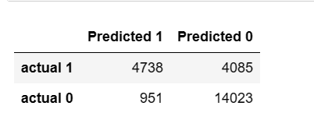
Logistic Regression
Based on accuracy values obtained, Model is not over fitted.
Based on confusion matrix, Model precision was well in class 0 than class 1.
1. For CLASS-0(non-cancellations):
Precision-77%-Model has moderately performed well
Recall- 94%- Model can identify a significant portion of actual non cancellations
2. For CLASS-1(Cancellations):
Precision-83%-Decent
Recall- 54%- Relatively lower suggesting it may miss some actual cancellations.
Overall, the model achieves 79% accuracy, including it correctly predicts 77% of instances.
Based on the confusion matrix results, the model’s performance is fairly good, with balanced precision and recall for both positive and negative instances.

Slide 15

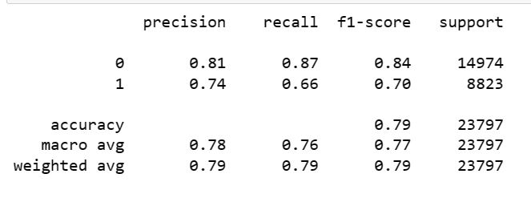
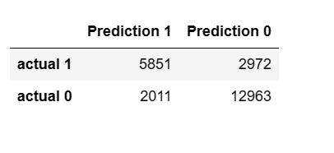
KNN
Based on accuracy values obtained, Model is not over fitted.
Based on confusion matrix, Model precision was well in class 0 than class 1.
1. For CLASS-0(non-cancellations):
Precision-81%-Model has moderately performed well
Recall-87%- Model can identify a significant portion of actual non cancellations
2. For CLASS-1(Cancellations):
Precision-74%
Recall- 66%- Relatively lower suggesting it may miss some actual cancellations.
Overall, the model achieves 79% accuracy, including it correctly predicts 85% of instances.
Based on the confusion matrix results, the model’s performance is fairly good.

Slide 16

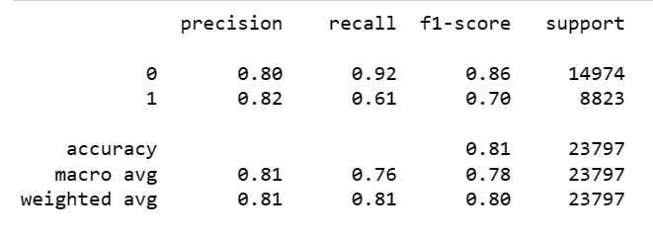
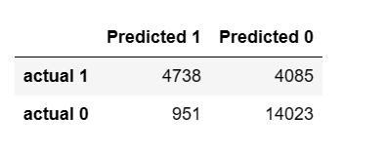
Neural Network
Based on accuracy values obtained, Model is not over fitted.
Based on confusion matrix, Model precision was well in class 0 than class 1.
1. For CLASS-0(non-cancellations):
Precision-80%-Model has moderately performed well
Recall-92%- Model can identify a significant portion of actual non cancellations
2. For CLASS-1(Cancellations):
Precision-82%
Recall- 61%- Relatively lower suggesting it may miss some actual cancellations.
Overall, the model achieves 81% accuracy, including it correctly predicts 85% of instances.
Based on the confusion matrix results, the model’s performance is fairly good

Slide 17

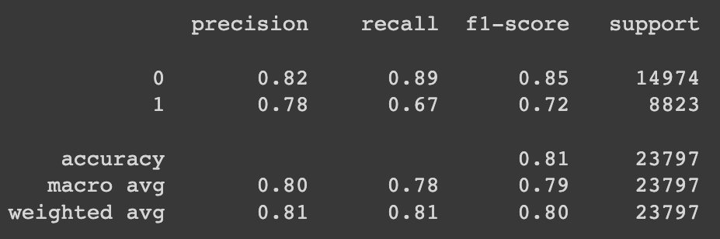
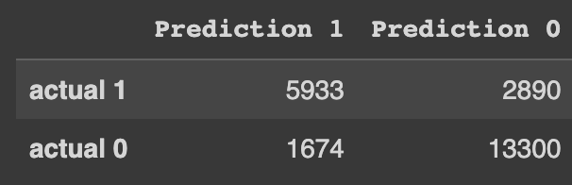
Decision Tree
SUMMARY
Based on accuracy values obtained, Model is not severely over fitting.
Based on classification report, Model performs well in class 0 than class 1.
1. For CLASS-0(non-cancellations):
Precision-82%-Model performs well
Recall- 89%- Model can identify a significant portion of actual non cancellations
2. For CLASS-1(Cancellations):
Precision-78%-Decent
Recall- 67%- Relatively lower suggesting it may miss some actual cancellations.
Overall, the model achieves 81% accuracy, including it correctly predicts 81% of instances.
Based on the confusion matrix results, the model’s performance is fairly good, with balanced precision and recall for both positive and negative instances.

Slide 18
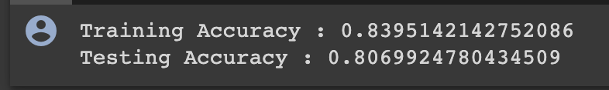
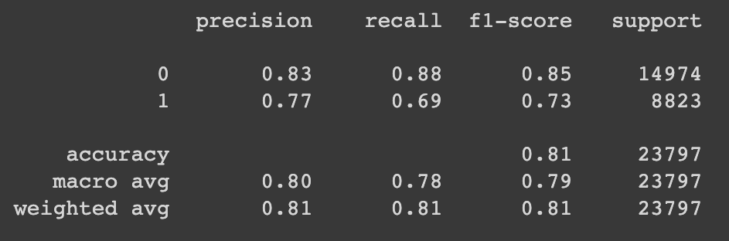
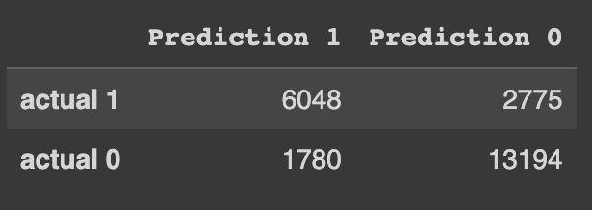
Random Forest
SUMMARY
Based on accuracy values obtained, Model is not severely over fitting.
Based on classification report, Model performs well in class 0 than class 1.
1. For CLASS-0(non-cancellations):
Precision-83%-Model performs well
Recall- 88%- Model can identify a significant portion of actual non cancellations
2. For CLASS-1(Cancellations):
Precision-77%-Decent
Recall- 69%- Relatively lower suggesting it may miss some actual cancellations.
Overall, the model achieves 81% accuracy, including it correctly predicts 81% of instances.
Based on the confusion matrix results, the model’s performance is fairly good, with balanced precision and recall for both positive and negative instances.

Slide 19
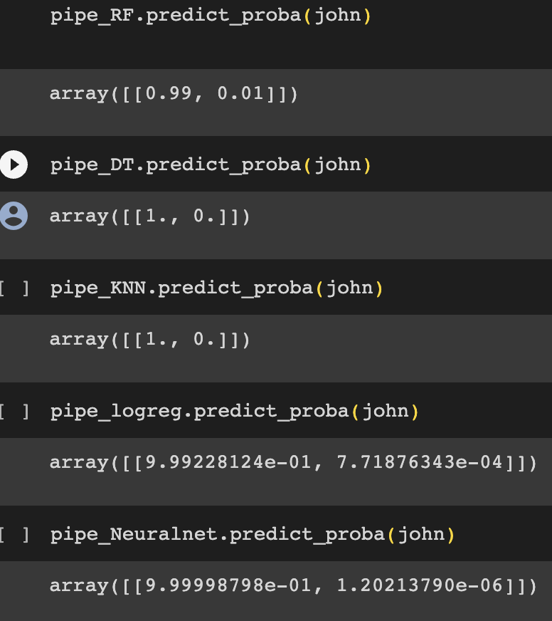
Final Conclusion
Based on the accuracy values, Random forest is the best model for this dataset among all the 5 models that we used.
Also, We have tested our model on dummy data set and based on the customer and booking information provided, all our models predicted high chances of booking confirmation.

